Slide 1
CSE7101- Capstone Project Review-4
PSCS_46_Application for Assessment of Quality of Textbook/ Reference Books/ E-Books
Batch Number: CSE_23
Under the Supervision of,
Guide – MS. Kummara Sruthi (Assistant Professor)
School of Computer Science and Engineering
Presidency University
Name of the Program: School Of Computer Science & Engineering
Name of the HoD: Dr. Asif Mohammed, Dr. Blessed Prince
Name of the Program Project Coordinator: Mr. Muthuraju V
Name of the School Project Coordinators: Dr. Sampath A K , Dr. Geetha A
Roll Number | Student Name
20221CSE0234 | Syed Thousif
20221CSE0213 | Patil Jashwanth Reddy
20221CSE0211 | Kambam Nithin Kumar Reddy
Roll Number | Student Name

Slide 2
Concentrate On These
Source Code Details (100%)
100% Implementation with Live Demo
80% Report Softcopy Submission-Draft (Abstract, Literature Review, System Design. Architecture, Algorithm Details Module Description)

Slide 3
Content
Objectives
Technology Stack
System Architecture
Key Features
Code Structure
Database Design
User Interface
Results & Performance
Conclusion
Github Link
References (IEEE Paper format)

Slide 4
Objectives
To develop an automated system for assessing textbook/e-book quality
To evaluate content using AI-based scoring (accuracy, readability, consistency)
To support multiple input formats: PDF, DOCX, TXT, and camera images
To provide a clean dashboard for evaluation results and history
To store all evaluations in a secure MongoDB database for future analysis

Slide 5
Technology Stack
Frontend: HTML5, CSS3
Backend: Python, Flask Framework
AI Model: Google Gemini API (Text + Image input)
Database: MongoDB with GridFS for large file storage
Libraries: PyPDF2, python-docx, werkzeug.security, bson, json
Tools: VS Code, MongoDB Compass/Atlas, Browser Developer Tools

Slide 6
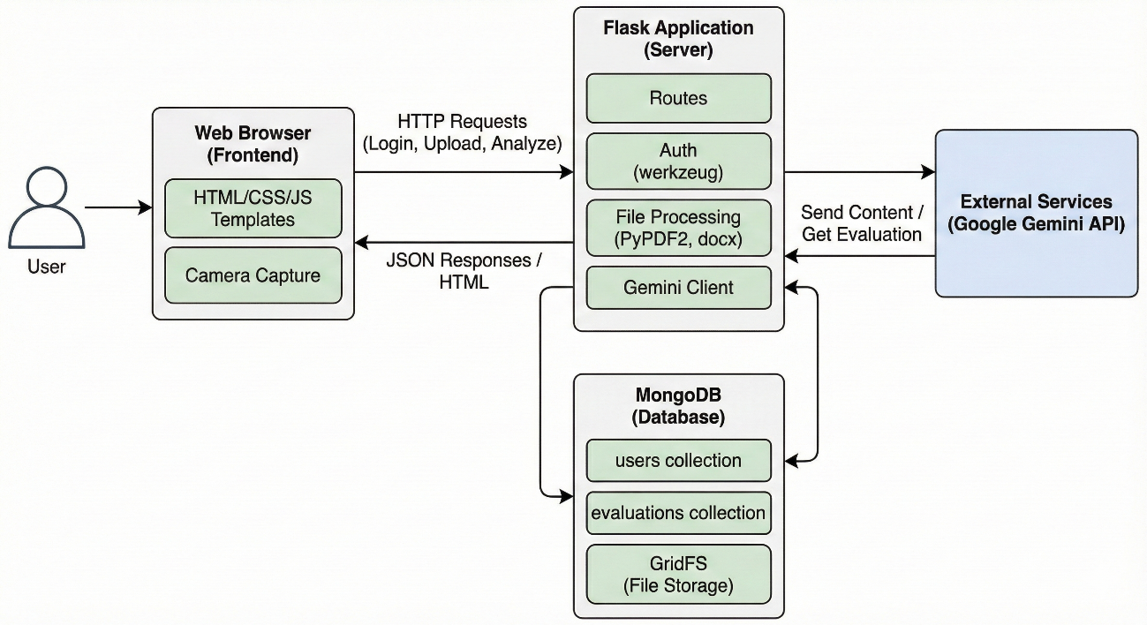
System Architecture
Client Layer:
File upload, camera capture, result display
Application Layer (Flask):
Routing (login, register, analyze, history)
Text extraction for PDF/DOCX/TXT
AI evaluation logic and validation
AI Layer (Gemini):
Processes text or image
Returns structured JSON evaluation
Database Layer (MongoDB):
User collection
Evaluation collection
GridFS for file storage

Slide 7
Key Features
User authentication (login/register)
Upload or capture textbook pages using camera
Automatic text extraction for document files
AI-powered evaluation with detailed scoring
Result cards with structured explanations
History panel showing previous evaluations
Secure file storage using GridFS
Responsive, modern UI with smooth interactions

Slide 8
Code Structure
Project.py – Entire application backend
Flask routes
AI evaluation logic
Text extraction utilities
MongoDB connections
HTML templates embedded as strings
Modules inside file:
Authentication module
Upload/Capture processing module
Gemini evaluation module
Storage & history module

Slide 9
Database Design
Collections
users
  username
  password_hash
  created_at
evaluations
  user_id
  file_id (GridFS)
  accuracy, readability, consistency scores
  explanations + summary
  timestamps
GridFS
Stores raw uploaded PDFs, DOCX, TXT, and captured images
Supports large files efficiently

Slide 10
User Interface
Clean, responsive dashboard layout
File upload section with supported formats
Integrated live camera for real-time page capture
Attractive result card with:
Scores
Explanations
Summary
History popup for previous evaluations
Consistent theme and color palette

Slide 11
Results & Performance
Successfully processes different file formats and images
Fast AI evaluation due to schema-optimized Gemini prompts
Accurate text extraction for PDF/DOCX/TXT
Real-time camera capture ensures flexibility
Storage & retrieval from MongoDB is fast and reliable
History panel displays up to 50 past evaluations efficiently

Slide 12
Conclusion
The system provides a quick, AI-driven assessment of textbook quality
Supports educators, reviewers, and academic institutions
Integrates multiple technologies for a smooth user experience
Flexible input options (file + camera) improve usability
Scalable and can be extended with:
Subject-specific evaluations
Multi-reviewer analysis
Admin dashboard and reporting
Serves as a strong foundation for AI-assisted academic quality analysis

Slide 13
Github Link
The Github link provided should have public access permission.
Github Link
https://github.com/SThousif/Application-for-Assessment-of-Quality-of-Textbook-Reference-Books-E-Books-

Slide 14
References (IEEE Paper format)
[1] Application for Assessment of Quality of Textbook/Reference Book/E-Books, International Journal of Engineering Innovations and Management Strategies, published circa early 2025 (about six months ago) IJEIMS.
[2] Q. Zhou, “Evaluating book impacts via integrating multi-source reviews,” Scientometrics, vol. 129, 2024
[3] R. K. Singh and A. Sharma, "Design and development of web-based evaluation system for academic resources," International Journal of Computer Applications, vol. 183, no. 8, pp. 25–30, June 2021.
[4] S. R. K. Somasekhar, P. V. Kumar, and R. J. Reddy, "Automated assessment of educational content using multi-criteria analysis," in Proc. IEEE International Conf. on Technology for Education (T4E), Mumbai, India, 2020, pp. 215–220.
[5] M. A. Al-Emran, "Towards an intelligent framework for textbook evaluation in higher education," Education and Information Technologies, vol. 24, no. 2, pp. 1453–1468, Mar. 2019.
[6] N. G. T. Izquierdo, L. A. G. Villalobos, and J. D. M. Ramírez, "A framework for the evaluation of e-learning materials," in Proc. IEEE Global Engineering Education Conf. (EDUCON), Abu Dhabi, UAE, 2016, pp. 1129–1134.
[7] T. M. Connolly and E. A. Stansfield, "Evaluating the quality of learning resources: A web-based approach," in Proc. IEEE International Conf. on Advanced Learning Technologies (ICALT), Athens, Greece, 2014, pp. 37–41.

Slide 15


